Slide 1
Instructions for signed numbers
MOVSX – move with Signed Extended
CBW, CWD, CWDE, CDQ
IMUL - multiplication
IDIV - division

Slide 2
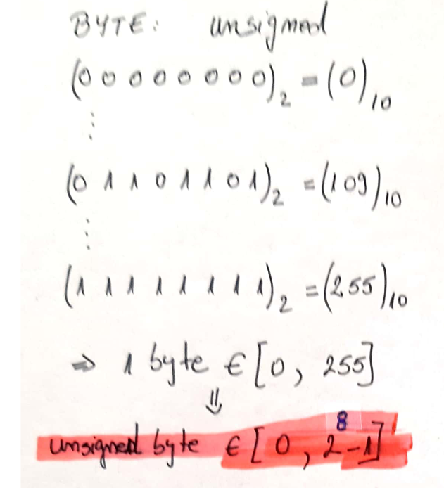
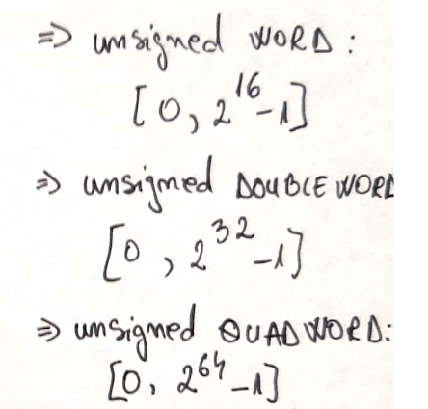
Unsigned and Signed numbers (1)

Slide 3
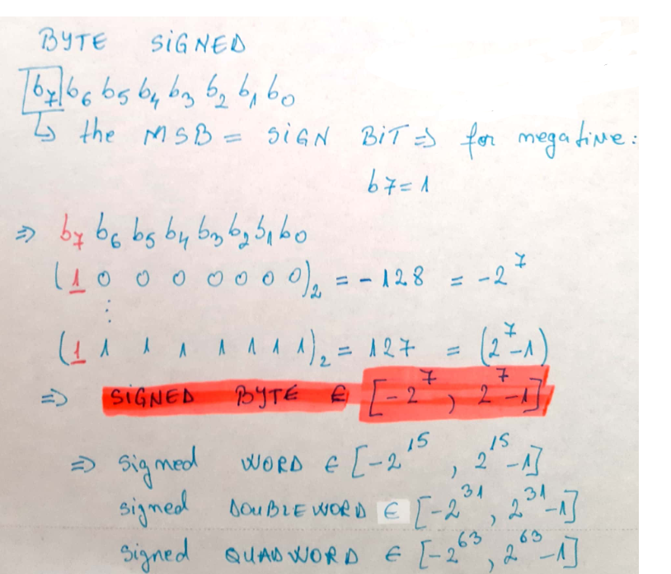
Unsigned and Signed numbers (2)

Slide 4
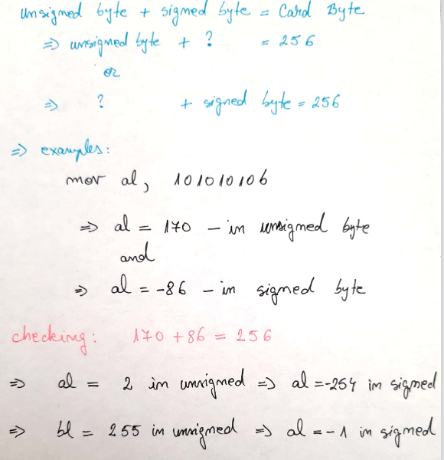

Slide 5
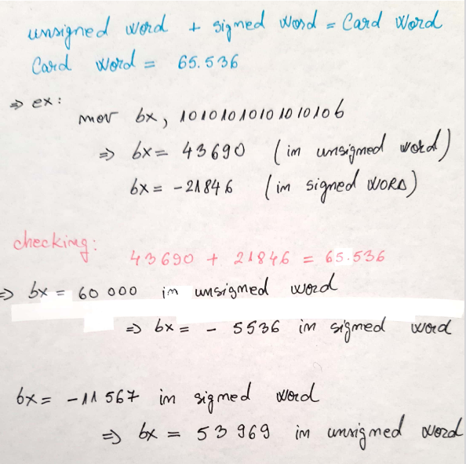
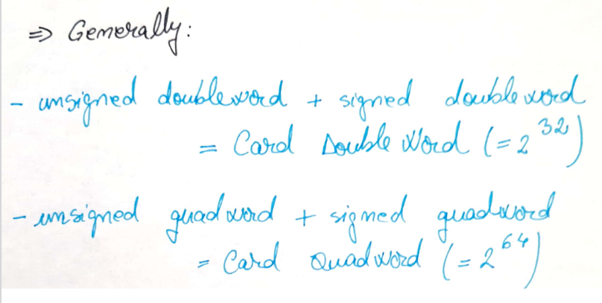

Slide 6
two's complement form (2's complement)
Computers store negative numbers in 2's complement form.
1 Convert the number to its binary form.
2. Complement the binary number, or invert each bit of the binary number. The resultant form is also known as 1's complement form.
3. Now add 1 to the 1's complement form. The result of this is the 2's complement form.
EG: the value of -5
5 = 0000 0101
1's complement = 1111 1010
Add 1 = + 1
------------------------------
2's complement = 1111 1011 (binary) = FB (hexa) = -5

Slide 7
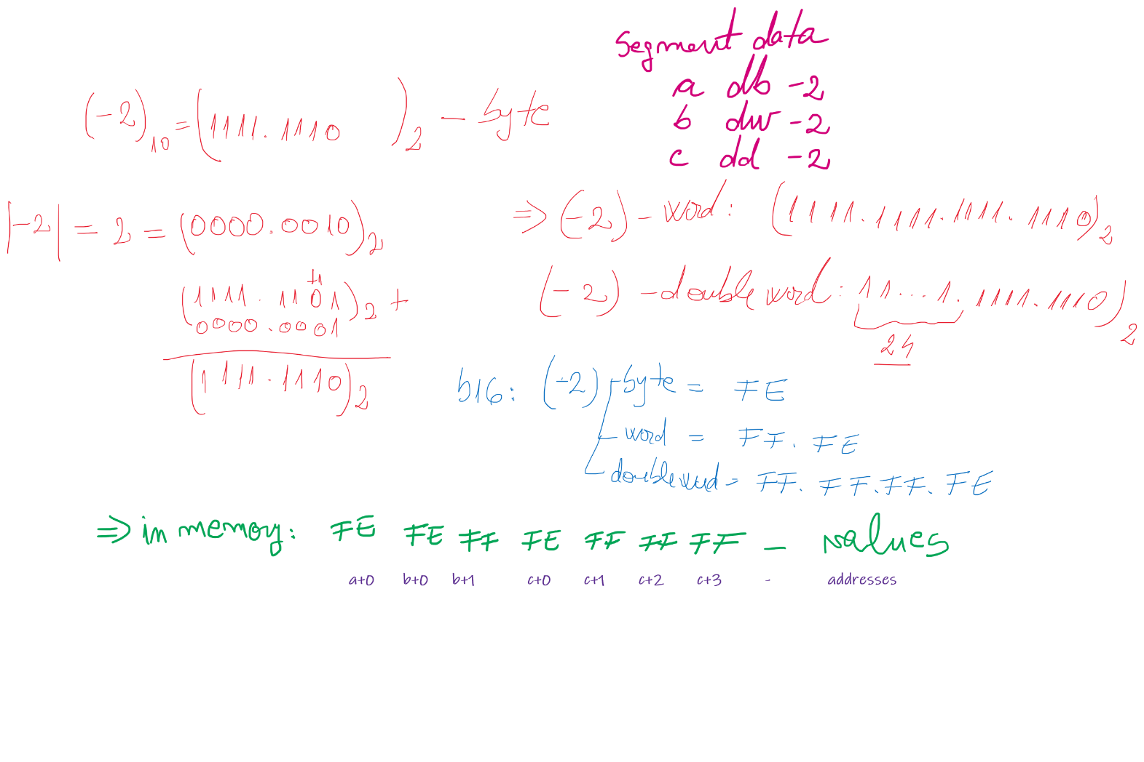

Slide 8
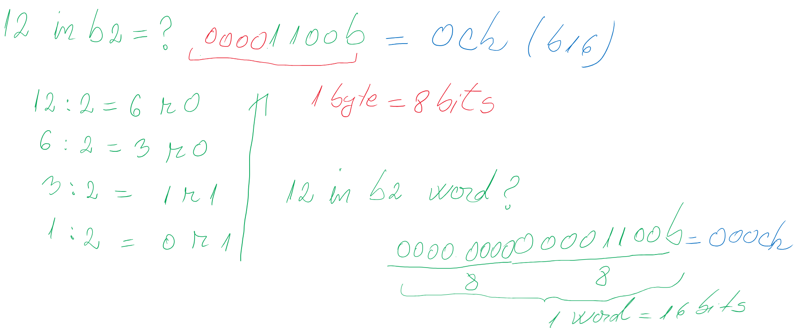
12 (natural number) in base 2?

Slide 9
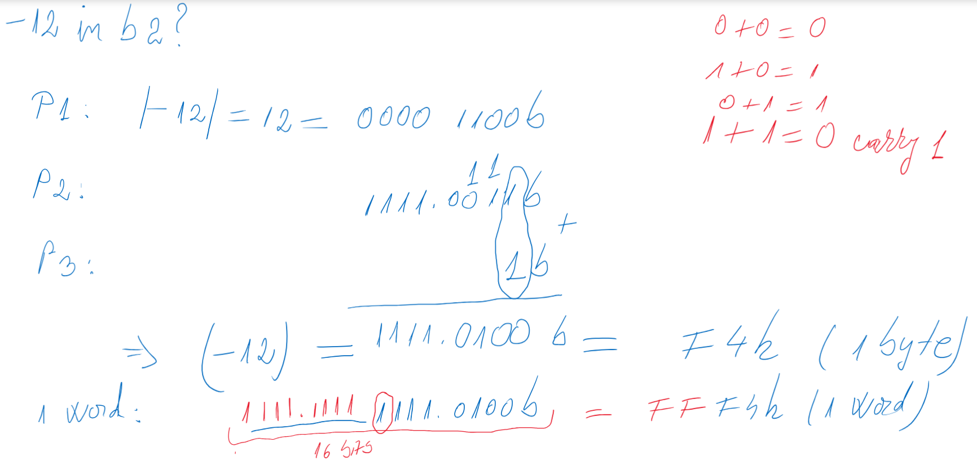
-12 (integer negative number) in base 2?

Slide 10
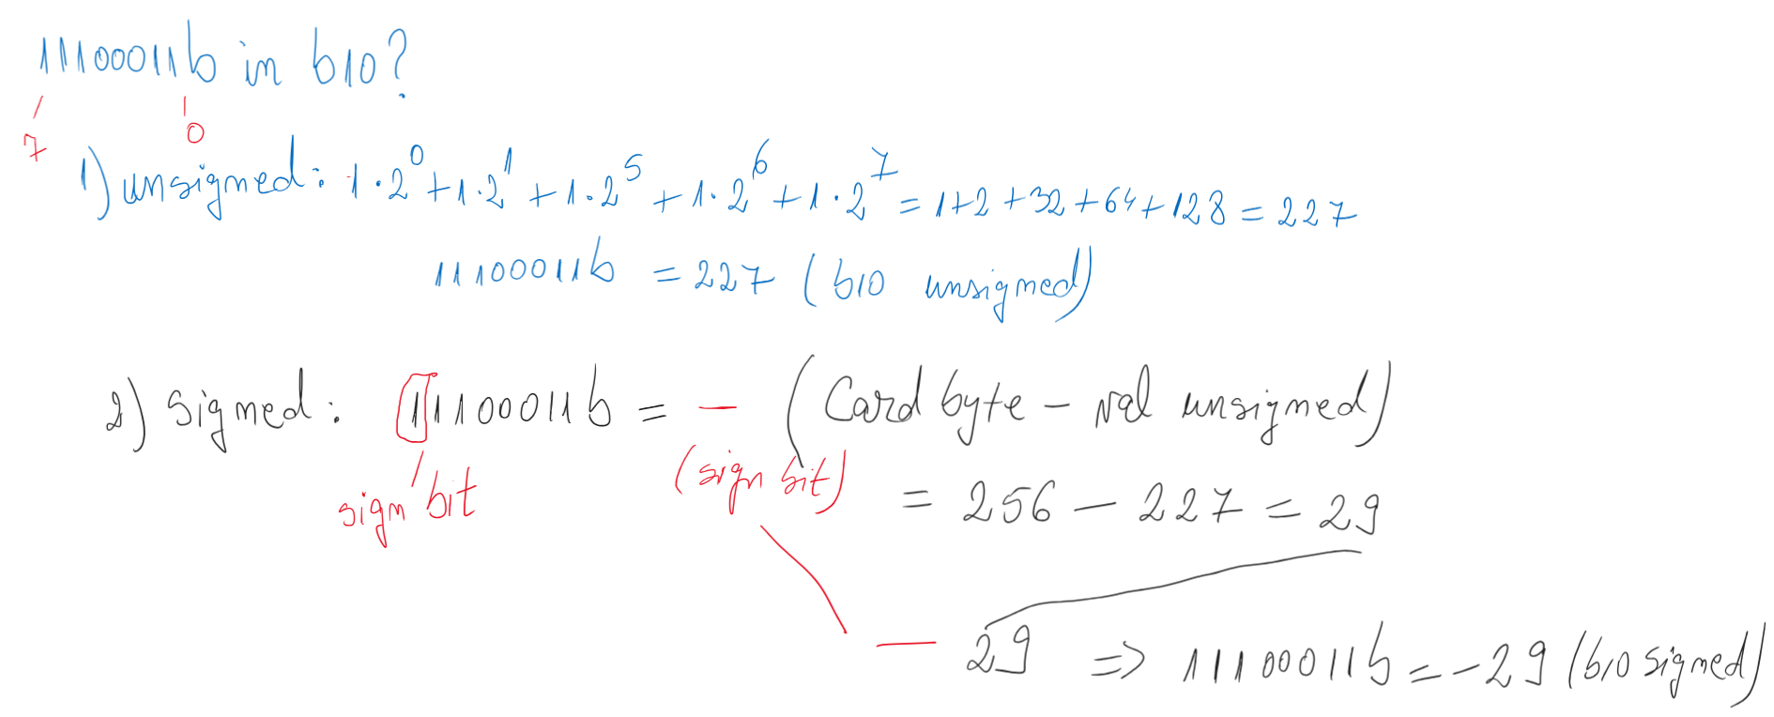
11100011b in base 10? How to interpret?

Slide 11
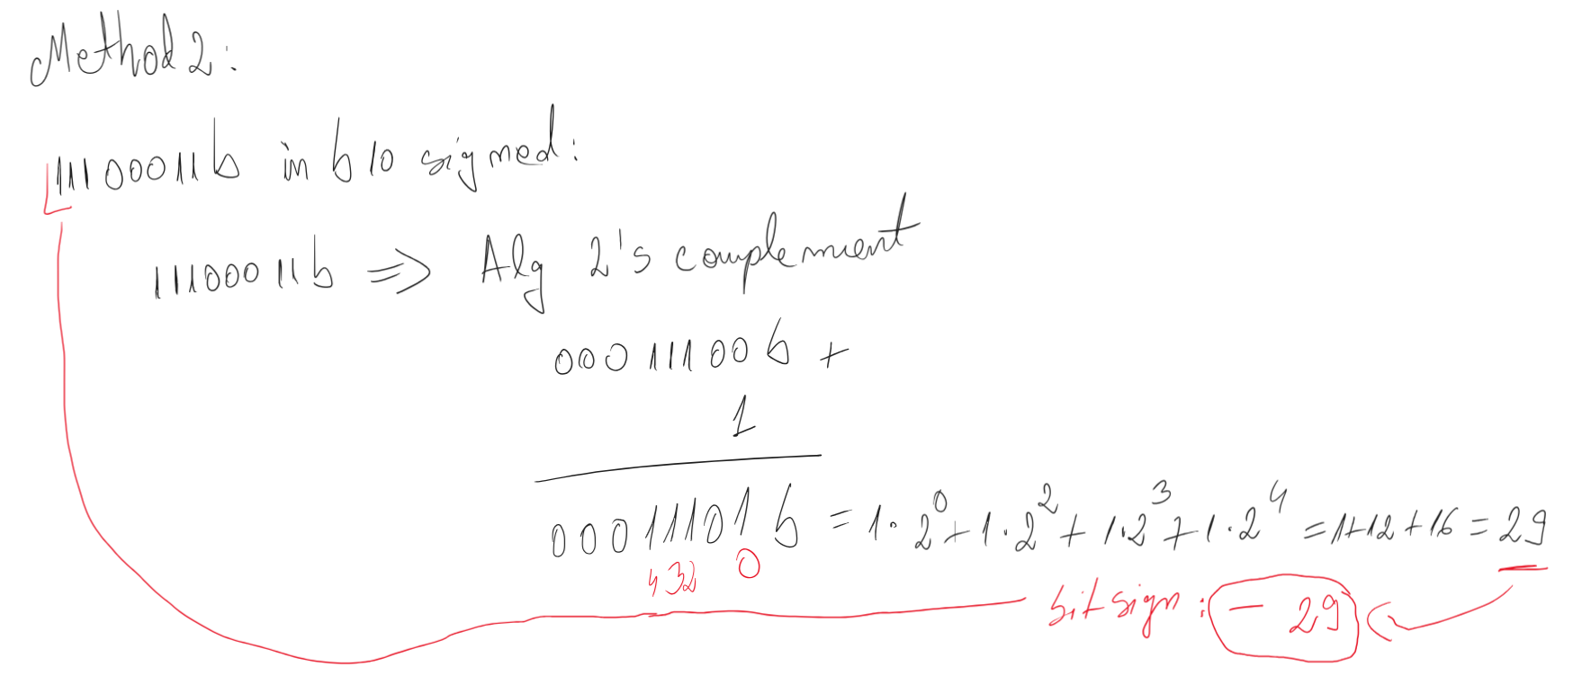

Slide 12
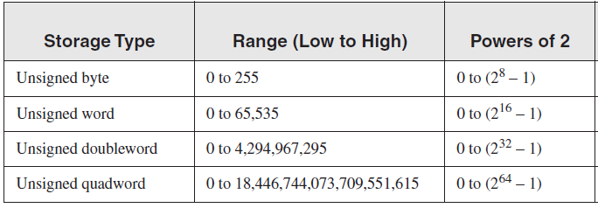
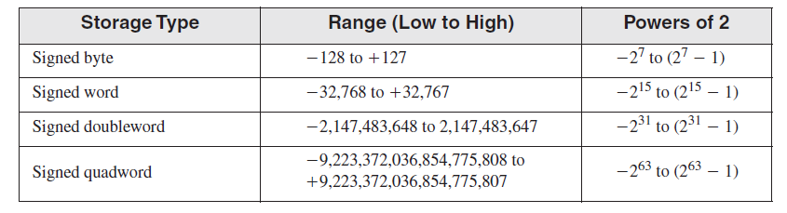
Storage sizes and ranges for unsigned and signed numbers

Slide 13
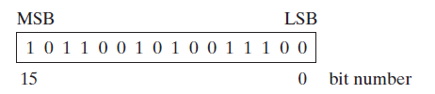
Signed conversions
Extension from a smaller data type to a larger data type based on a sign bit
In sign representation, the most significat bit is sign bit
Bit sign

Slide 14
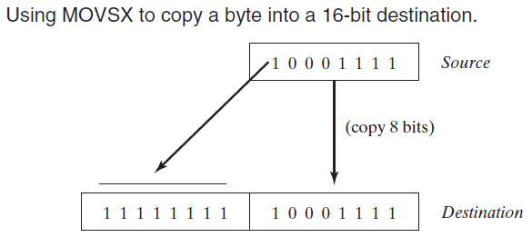
MOVSX instruction (move with sign-extend)
copies the contents of a source operand into a destination operand and sign-extends the value to 16 or 32 bits
MOVSX reg16, reg/mem8
MOVSX reg32, reg/mem8
MOVSX reg32, reg/mem16
Examples:
byteVal db 10001111b
movsx ax, byte[byteVal] ; AX = 1111111110001111b
mov bx, 0F6FBh
movsx eax, bx ; EAX = FFFFF6FBh
movsx edx, bl ; EDX = FFFFFFFBh
movsx cx, bl ; CX = FFFBh
Notes:
The MOVSX instruction (move with sign-extend) copies the contents of a source operand into a destination operand and sign-extends the value to 16 or 32 bits. This instruction is only used with signed integers. There are three variants:
MOVSX reg32,reg/mem8
MOVSX reg32,reg/mem16
MOVSX reg16,reg/mem8
An operand is sign-extended by taking the smaller operand’s highest bit and repeating (replicating) the bit throughout the extended bits in the destination operand. The following example sign-extends
The lowest 8 bits are copied as in Figure 4–2. The highest bit of the source is copied into each of the upper 8 bit positions of the destination

Slide 15
CBW
The instruction does not have any explicitly specified operands because it is always converting AL → AX
Converts the byte AL to the word AX in the signed interpretation (saves in AH the bit sign)
The conversion refers to the extension of the representation from 8 bits to 16 bits, by filling AH with the sign bit of AL
Eg1:
mov AL, 01110111b
cbw ; AX ← 00000000 01110111b
Eg2:
mov AL, 11110111b
cbw ; AX ← 11111111 11110111b
Eg3:
Mov bl, -1
Mov al, bl
Cbw ; ax = -1

Slide 16
CWD
The instruction does not have any explicitly specified operands because it is always converting AX → DX:AX
Converts the word AX to the doubleword DX:AX in the signed interpretation
The conversion refers to the extension of the representation from 16 bits to 32 bits, by filling DX with the sign bit of AX
Eg1.
mov ax, 00110011 11001100b
cwd ; DX:AX ← 00000000 00000000 00110011 11001100b
Eg2.
mov ax, 10110011 11001100b
cwd ; DX:AX ← 11111111 11111111 10110011 11001100b

Slide 17
CWDE
The instruction does not have any explicitly specified operands because it is always converting AX → EAX
Converts the word AX to the doubleword EAX in the signed interpretation
The conversion refers to the extension of the representation from 16 bits to 32 bits, by filling the high word of EAX with the sign bit of AX
Eg1:
mov ax, 00110011 11001100b
cwde ; EAX ← 00000000 00000000 00110011 11001100b
Eg2:
mov ax, 10110011 11001100b
cwde ; EAX ← 11111111 11111111 10110011 11001100b

Slide 18
CDQ
The instruction does not have any explicitly specified operands because it is always converting EAX → EDX:EAX
Converts the doubleword EAX to the qword EDX:EAX in the signed interpretation
The conversion refers to the extension of the representation from 32 bits to 64 bits, by filling EDX (the high doubleword) with the sign bit of EAX.
Eg1:
mov eax, 00110011 11001100 00110011 11001100b
cdq ; EDX:EAX ← 00000000 00000000 00000000 00000000 00110011 11001100 00110011 11001100b
Eg2:
mov eax, 10110011 11001100 10110011 11001100b
cdq ;EDX:EAX ← 11111111 11111111 11111111 11111111 10110011 11001100 10110011 11001100b

Slide 19
Multiplication and Division instructions for signed representation
signed representation
contains both positive and negative numbers
Notes:
How does the CPU know whether an arithmetic operation is signed or unsigned?
It doesn’t! The CPU sets all status flags after an arithmetic operation using a set of boolean rules, regardless of which flags are relevant.
the programmer decideS which flags to interpret and which to ignore, based on your knowledge of the type of operation performed.

Slide 20
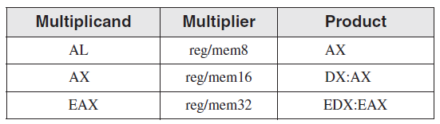
Multiplication Instruction (for signed representation)
Syntax: IMUL op
op is called explicit operand
The MUL is realized different accordind to the explicit operand:
op is reg/mem8 => IMUL reg/mem8 => AL * reg/mem8 = AX
op is reg/mem16 => IMUL reg/mem16 => AX * reg/mem16 = DX:AX
op is reg/mem32 => IMUL reg/mem32 => EAX * reg/mem32 = EDX:EAX
Notes:
The single operand in the MUL instruction is the multiplier. Table 7-2 shows the default multiplicand and product, depending on the size of the multiplier. Because the destination operand is twice the size of the multiplicand and multiplier, overflow cannot occur.
MUL sets the Carry and Overflow flags if the upper half of the product is not equal to zero.
The Carry flag is ordinarily used for unsigned arithmetic, so we’ll focus on it here.
When AX is multiplied by a 16-bit operand, for example, the product is stored in the combined DX and AX registers.
That is, the high 16 bits of the product are stored in DX, and the low 16 bits are stored in AX.
The Carry flag is set if DX is not equal to zero, which lets us know that the product will not fit into the lower half of
the implied destination operand.
A good reason for checking the Carry flag after executing MUL is to know whether the upper half of the
product can safely be ignored.

Slide 21
Examples: op is reg/mem8 => IMUL reg/mem8 => AL * reg/mem8 = AX
Eg 1: -3*4
mov al, -3
mov bl, 4
imul bl ;al*bl = ax
Eg 2: c*(-4), c byte
mov al, -4
imul byte [c] ;al*[c]=ax
or
mov al, [c]
mov bl, -4
imul bl; al*bl=ax
Eg. 3 a*b, a, b bytes
a db -2
b db -5
mov al, [a]
imul byte[b] ; al*[b] = ax
or
mov al, [a]
mov bl, [b]
imul bl ; al*bl = ax

Slide 22
Examples: op is reg/mem16 => IMUL reg/mem16 => AX * reg/mem16 = DX:AX
Eg 1: -3*(-5)
mov ax, -3
mov bx, -5
imul bx ;ax*bx = dx:ax
Eg 2: c*(-4), c word
mov ax, -4
imul word [c] ;ax*[c]=dx:ax
or
mov ax, [c]
mov bx, -4
imul bx; ax*bx=dx:ax
Eg. 3: m*n, m, n word
m dw -6
n dw 7
mov ax, [m]
imul word[n] ; [m]*[n]=ax:ax
Eg. 4: p*r, p-byte, r-word
mov al, [p]
CBW ;ax = [p]
imul word[r] ; [p]*[r]=dx:ax

Slide 23
Examples: op is reg/mem32 => IMUL reg/mem32 => EAX * reg/mem32 = EDX:EAX
Eg. 1: e*f, e, f doubleword
mov eax, [e]
imul dword[f] ; edx:eax=e*f
Eg. 2: g*h, g-byte, h-doubleword
mov al, [g]
CBW ; AX= [g]
CWDE ; EAX= [g]
imul dword[h] ;edx:eax=rez g*h
Eg. 3: 2*f, e, f doubleword
mov eax, 2
imul dword[f] ; edx:eax=2*f
Eg. 4: i*j, i-word, j-doubleword
mov ax, [i] ;AX=[i]
CWDE ;EAX=[i]
imul dword[j] ;edx:eax=i*j

Slide 24
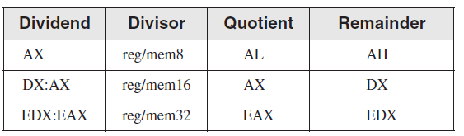
Division Instruction (for signed representation)
Syntax: IDIV op
op is called explicit operand
The DIV is realized different according to the explicit operand:
op is reg/mem8 => IDIV reg/mem8 => AX / reg/mem8 = AL – quotient
and AH – remainder
op is reg/mem16 => IDIV reg/mem16 => DX:AX / reg/mem16 = AX – quotient
and DX – remainder
op is reg/mem32 => IDIV reg/mem32 => EDX:EAX / reg/mem32 = EAX – quotient
and EDX – remainder

Slide 25
Examples: op is reg/mem8 => IDIV reg/mem8 => AX / reg/mem8 = AL – quotient and AH – remainder
Eg. 1: m/n = > word/byte
m dw -31
n db 10
mov ax, [m] ; ax = [m]
idiv byte[n] ;ax/[n] = al-cat, ;ah –rest
Eg. 2: -5/r => constant/byte
r db 2
mov ax, -5
idiv byte[r] ;ax/[r] = al-cat, ah-rest
Eg. 3: a/b => byte/byte
a db -20
b db 6
mov al, [a]
cbw ;ax = [a]
mov bl, [b]
idiv bl ; ax / bl = a/b = al cat, ; ah-rest
;sau idiv byte[b]

Slide 26
Examples: op is reg/mem16 => IDIV reg/mem16 => DX:AX / reg/mem16 = AX – quotient and DX – remainder
Eg. 1: m/n = > word/word
m dw 31
n dw -10
mov ax, [m] ; ax = [m]
CWD ;dx:ax = [m]
idiv word[n] ;dx:ax/[n] = ax-cat, ;dx, rest
Eg. 2: 5/r => constant/word
r dw -4
mov ax, 5
CWD ; dx:ax = 5
idiv word[r] ;dx:ax/[r] = ax-cat, ;dx, rest
Eg. 3: a/b => byte/word
a db -20
b dw 6
mov al, [a]
CBW ;ax = [a]
CWD ;dx:ax = [a]
mov bx, [b]
idiv bx ; dx:ax / bx = a/b = ax cat, ; dx rest

Slide 27
Examples: op is reg/mem32 => IDIV reg/mem32 => EDX:EAX / reg/mem32 = EAX – quotient and EDX – remainder
Eg. 1: m/n = > word/doubleword
m dw -32
n dd 11
mov ax, [m] ; ax = [m]
CWDE ; eax = [m]
CDQ ;edx:eax = [m]
idiv dword[n] ;edx:eax/[n] = eax-cat, ;edx, rest
Eg. 2: 5/r => constant/doubleword
r dd -3
mov eax, 5
CDQ
idiv dword[r] ;edx:eax/[r] = eax-cat, edx, rest
Eg. 3: a/b => byte/doubleword
a db 16
b dd -3
mov al, [a] ; al=[a]
CBW ;ax = [a]
CWDE ;eax =[a]
CDQ ;edx:eax = [a]
idiv dword[b] ;eax – cat, edx, avem rest
Eg. 4 c/d =>word/doubleword
c dw 41
d dd -10
mov ax, [c] ; ax = [c]
CWDE ;eax =[c]
CDQ ;edx:eax = [c]
idiv dword[d] ;eax – cat, edx, avem rest

Slide 28
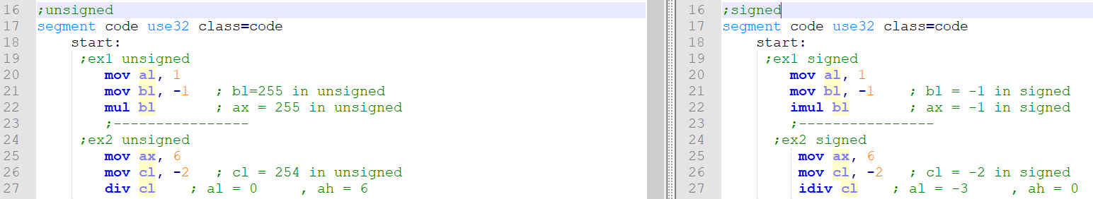
Comparisons Unsigned vs. Signed (1)

Slide 29
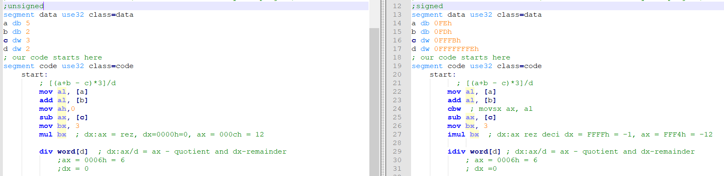
Comparisons: Unsigned vs. Signed (2)

Slide 30
Solve in signed:
-10/B + A*(-2) - D/C - in signed
A BYTE 10
B WORD -2
C DOUBLEWORD -3
D DOUBLEWORD -10

Slide 31
XCHG (exchange data) instruction
XCHG reg,reg
XCHG reg,mem
XCHG mem,reg
Examples:
xchg ax,bx ; exchange 16-bit regs
xchg ah,al ; exchange 8-bit regs
xchg [var1], bx ; exchange 16-bit mem op with BX
xchg eax,ebx ; exchange 32-bit regs
To exchange two memory operands, use a register as a temporary container and combine MOV with XCHG:
mov ax, [val1]
xchg ax, [val2]
mov [val1], ax
Notes:
The XCHG (exchange data) instruction exchanges the contents of two operands. There are three
variants:
XCHG reg,reg
XCHG reg,mem
XCHG mem,reg
The rules for operands in the XCHG instruction are the same as those for the MOV instruction, except that XCHG does not accept immediate operands. In array sorting applications, XCHG provides a simple way to exchange two array elements. Here are a few
examples using XCHG:
xchg ax,bx ; exchange 16-bit regs
xchg ah,al ; exchange 8-bit regs
xchg var1,bx ; exchange 16-bit mem op with BX
xchg eax,ebx ; exchange 32-bit regs
To exchange two memory operands, use a register as a temporary container and combine MOV
with XCHG:
mov ax,val1
xchg ax,val2
mov val1,ax

Slide 32
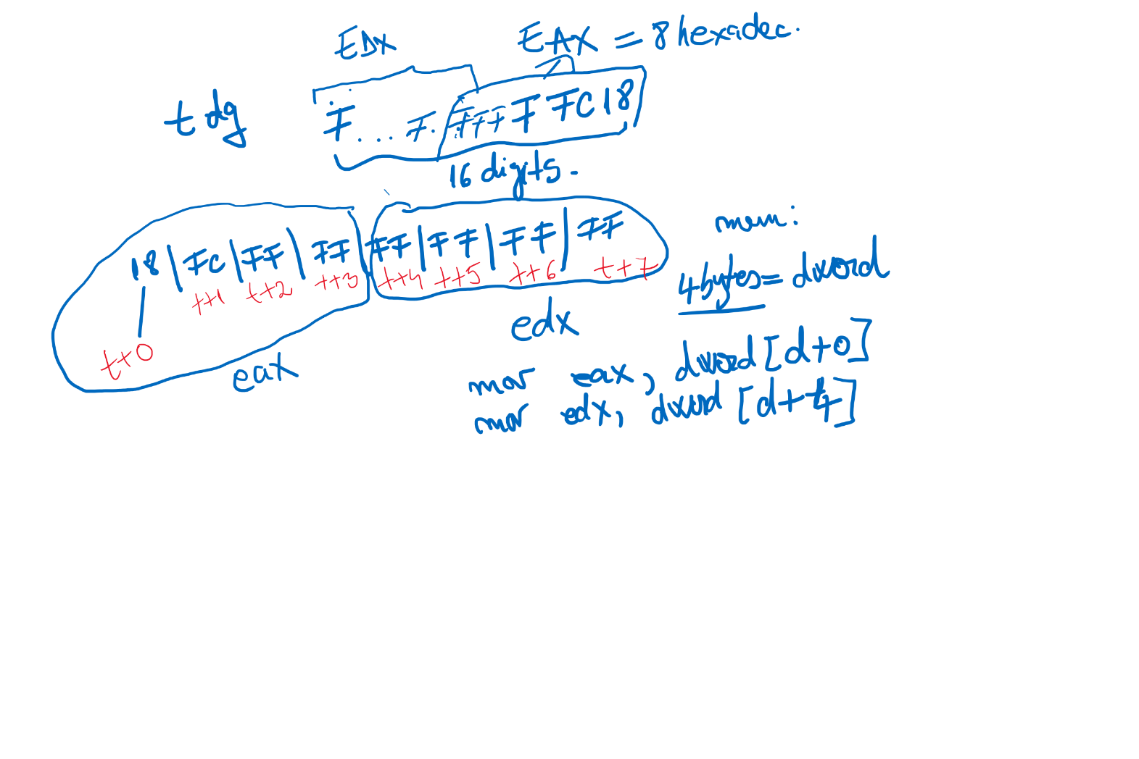

Slide 33
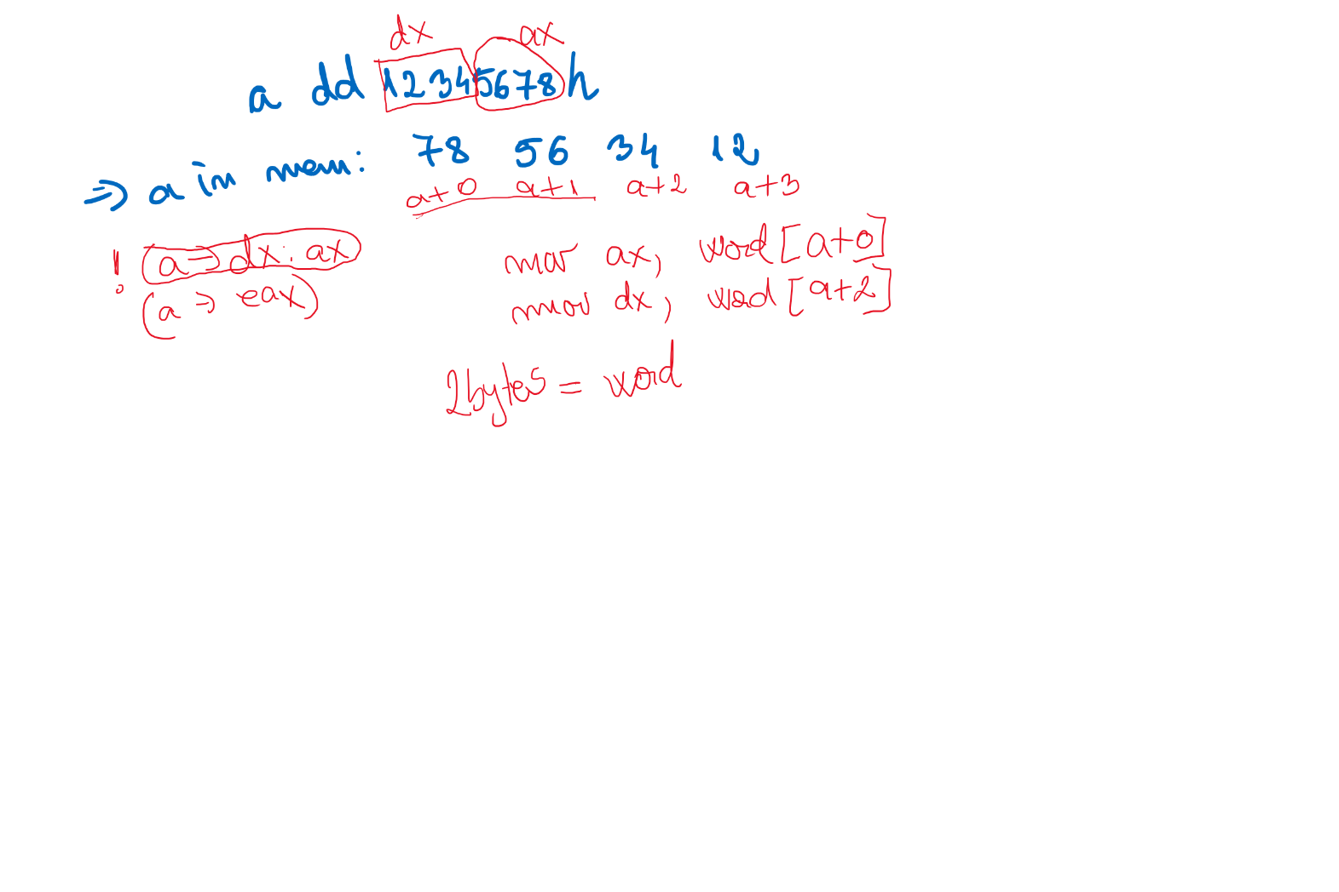

Slide 34
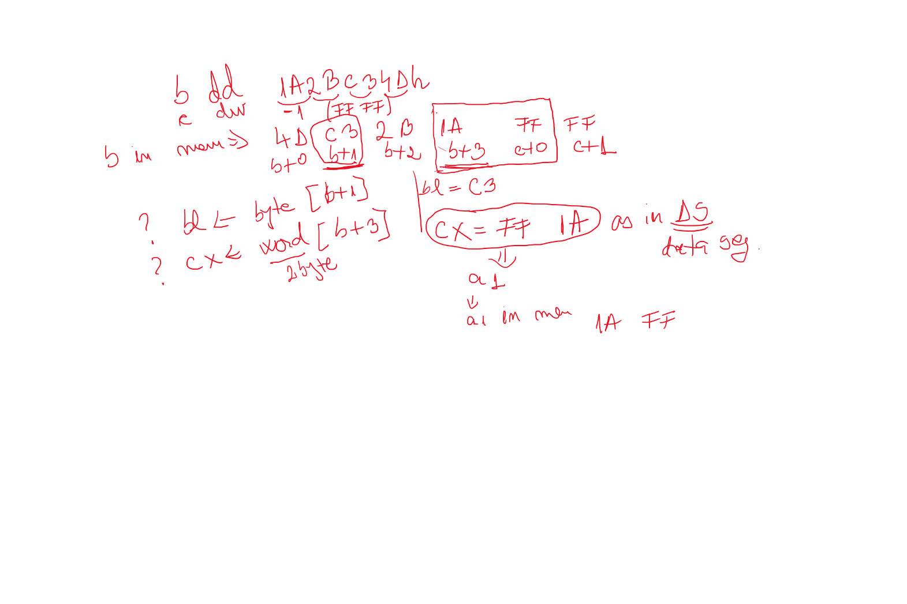

Slide 35
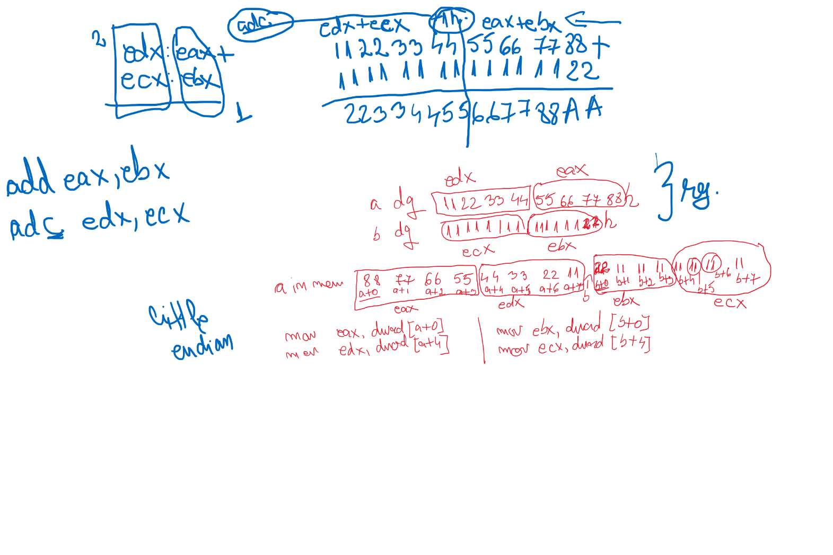

Slide 36
